Slide 1
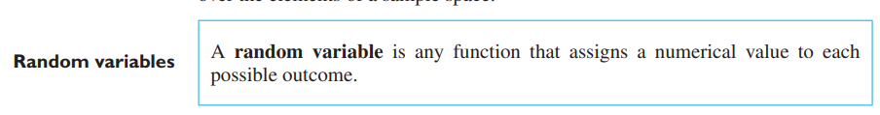
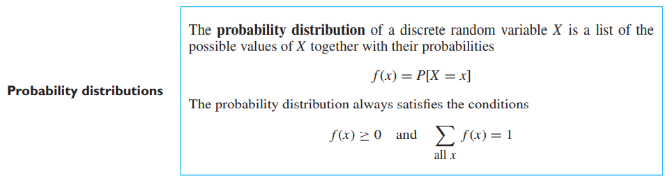

Slide 2
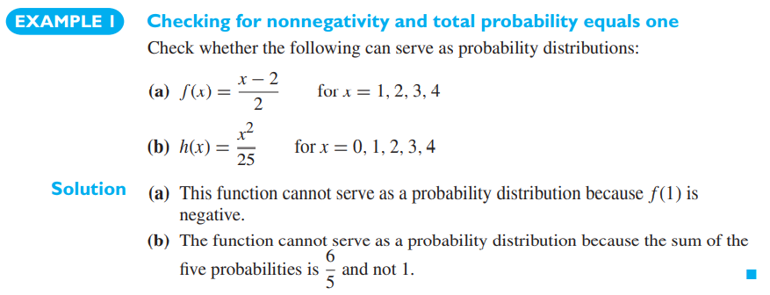

Slide 3
Binomial Probability Distribution
In binomial probability distribution,
the number of ‘Success’ in a sequence of n experiments, where each time a question is asked for yes-no, then the boolean-valued outcome is represented either with success/yes/true/one (probability p) or
failure/no/false/zero (probability q = 1 − p).
A single success/failure test is also called a Bernoulli trial or Bernoulli experiment, and a series of outcomes is called a Bernoulli process.
For n = 1, i.e. a single experiment, the binomial distribution is a Bernoulli distribution. The binomial distribution is the base for the famous binomial test of statistical importance.

Slide 4
They are all composed of a series of trials which we refer to as Bernoulli trials if the following assumptions hold.
There are only two possible outcomes for each trial (arbitrarily called “success” and “failure,” without inferring that a success is necessarily desirable).
The probability of success is the same for each trial.
The outcomes from different trials are independent.
There are a fixed number n of Bernoulli trials conducted.

Slide 5

Binomial Distribution Formula
The binomial distribution formula is for any random variable X, given by;
Where,
n = the number of experiments
x = 0, 1, 2, 3, 4, …
p = Probability of Success in a single experiment
q = Probability of Failure in a single experiment = 1 – p
The binomial distribution formula can also be written in the form of n-Bernoulli trials, where ^{n}C_{x} = n!/x!(n-x)!. Hence,
P(x:n,p) = n!/[x!(n-x)!].p^{x}.(q)^{n-x}

Slide 6
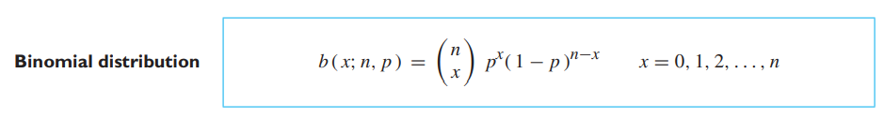
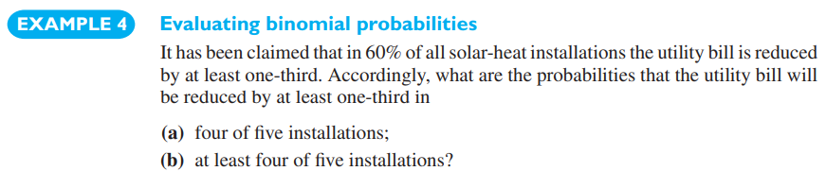
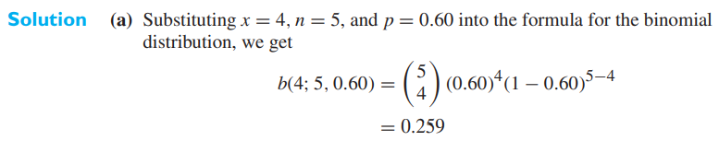
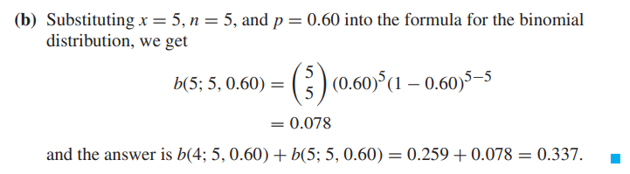

Slide 7
Binomial Distribution Mean and Variance
For a binomial distribution, the mean, variance and standard deviation for the given number of success are represented using the formulas
Mean, μ = np
Variance, σ² = npq
Standard Deviation σ= √(npq)
Where p is the probability of success
q is the probability of failure, where q = 1-p

Slide 8
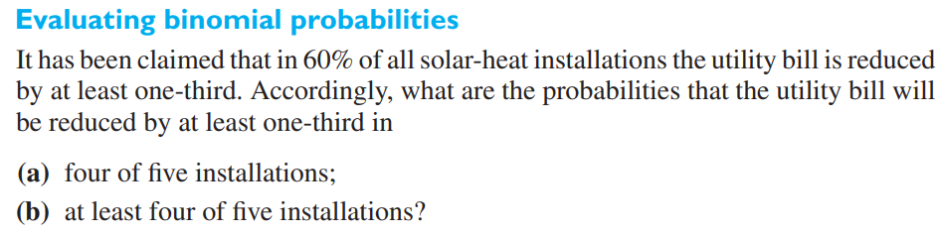

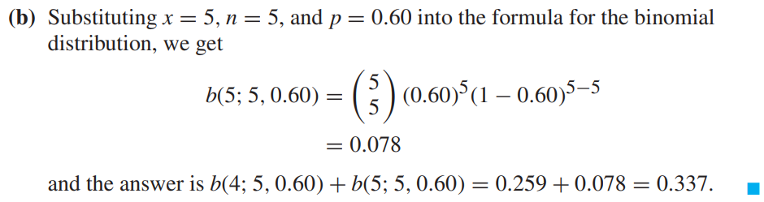

Slide 9
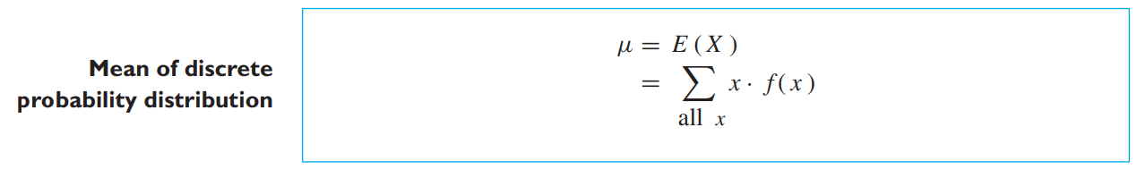
The mean of a probability distribution measures its center in the sense of an average,

Slide 10
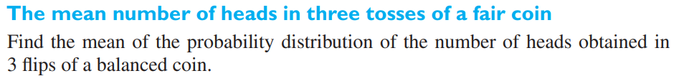
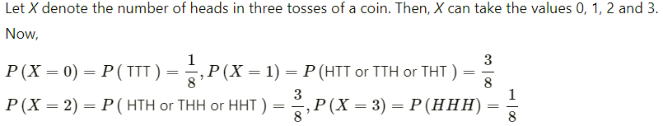

Slide 11
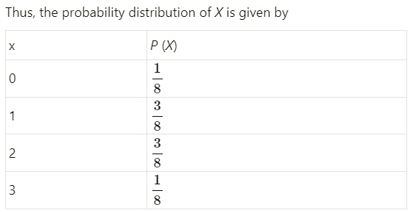

Slide 12
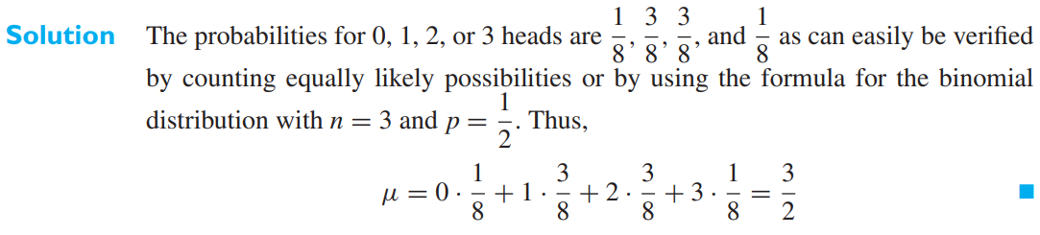

Slide 13
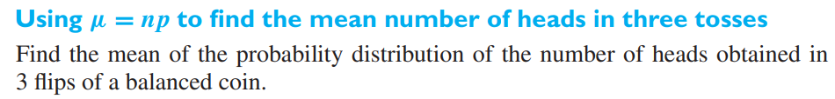



Slide 14
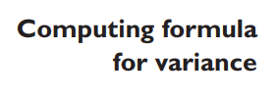
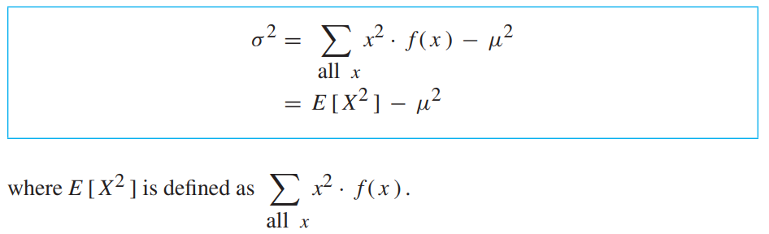

Slide 15
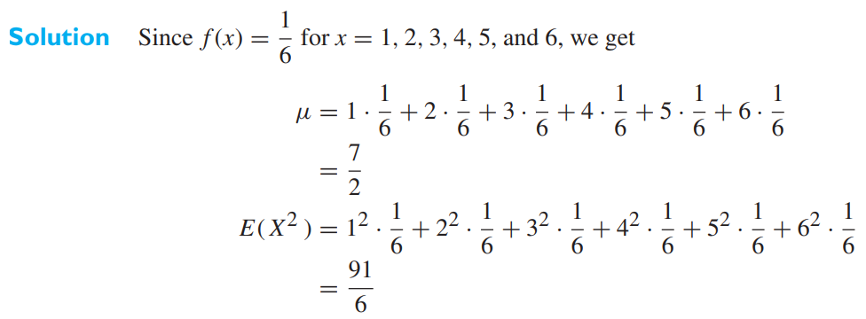
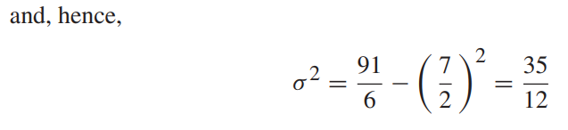
To determine the variance of the probability distribution of the number of points rolled with a balanced dice.

